Slide 1

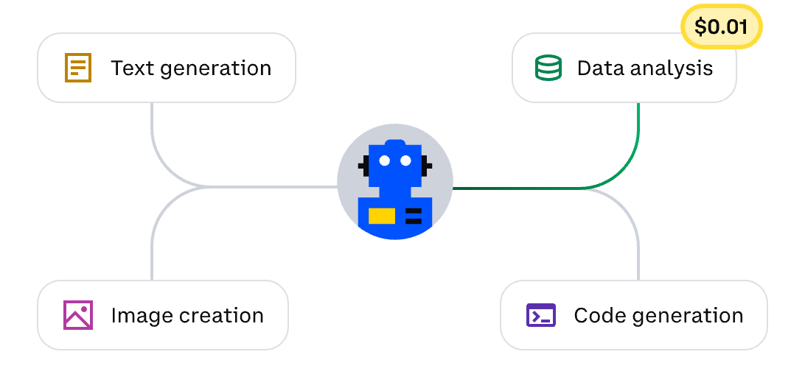
Agentic Pay
The Payment Layer for the AI Agent Economy
2026-01

Slide 2


One day in 20XX year…
Product Demo Video

Slide 3



What is AI Payment Workflow
Use it, and AI payment happens automatically
User input
Smart dispatch
Task execution
AI payment
Results delivered
The user describes the need in chat, or submits programmatic batch jobs.
The system automatically selects the most suitable agent.
The agent completes the work with transparent costs.
When the task finishes, the system calculates the total and pays automatically.
The user receives the final results, a cost breakdown, and a receipt/audit log.
Intelligent Dispatch
Transparent Billing
Instant Settlement
No more manual Agent marketplace search required.
Every micro-cost tracked and auditable.
Payouts completed the moment a task is done.
Notes:
787ba294-3ebd-4a93-b8f5-a7d363bc69f9.source.default.zh-Hans

Slide 4




Our Agentic Pay: P.A.I.D.
Making Every AI Transaction
Trustworthy
P: Payment
A robust, multi-rail payment network supporting stablecoins, fiat currency, and traditional banking systems. Built for global, instant transactions.
From Opacity to Transparency,
Reactive to Intelligent,
Risk to Trust.
A: Agent
I: Insights
D: Diligence
Precisely track and attribute every cost to the originating Agent, task, or customer. Full visibility into cost sources and destinations.
Leverage payment data to provide intelligent pricing recommendations, cost optimization insights, and Agent performance analytics.
A multi-layered evaluation system (KYA – Know Your Agent) ensuring every transaction is secure.

Slide 5



Stablecoins Enable Instant, Low-Cost Payments
Web3.0 Native
Lightning Speed
Viable Transaction Ready
One universal payment rail for Agents in any country.
Near‑instant, on‑chain finality.
Economically viable for payments from $0.0001 to $N.
Feature | Agentic Pay | Bank Transfer | PayPal/Strip | Bitcoin Layer1
Average Fee | < $0.0001 | $0.30 + 2.9% | ~3% + markup | $1–$5 + gas
Settlement Finality | ~2 seconds | Days (batch) | Instant authorization, days for net settlement | ~1–2 minutes for confirmations
Chargebacks | No | Yes, up to 120 days (batch) | Yes | Not reversible
Scalability (TPS) | Hundreds to thousands TPS | 24,000 TPS globally | Varies; limited by account/provider | ~15–20 TPS

Slide 6







From Renting AI Tools to Buying Agent Outcomes
Traditional SaaS
AI Agent Pricing
The Outcome Economy
What you pay for
Value Anchor
Value Anchor
Completed Tasks & Results
Access to features
Quality of outcome
Unit of Charge
Unit of Charge
Efficiency
Per seat, per month
Per successful result
100% Utilization (Pay-as-you-go)
Cost Structure
Cost Structure
High fixed, zero marginal
Variable compute costs
Pricing Logic
Pricing Logic
Competitor-based
Quantify value created by AI
85% Savings
Value Alignment
Risk Mitigation
Shared Success
Stop paying for ”AI Tax"
Start paying for value!

Slide 7




Complete Visibility & Control
User：Check this supplier contract and tell me the key risks, the important terms, and whether we should proceed.
Payment Processing
01
High-Throughput
Atomic Ledger
Real-Time Clearing
Data Record
LIVE FEED
Agent Name
Context
02
Full-Chain Provenance
Granular Attribution
Tamper-Proof
Cost
Legal-Analyzer
Parses contracts and laws to …
$0.4200
Cost Management
File-Search
Finds and ranks relevant ….
$0.0015
03
Budget Controls
Anomaly Detection
Optimization Insights
Data-Miner
Extracts, cleans, and structures ….
$0.0300
Financial
Compliance
Email-Drafter
Turns bullet points into polished …
$0.0800
04
Automated Accounting
Global Tax Compliance
Audit-Ready Data
Sheet-Tools
Auto-extracts fields from text ….
$1.1000
Session Total
$1.6315

Slide 8






Know Your Agent (KYA)
Verified before a cent is paid, monitored so trust won’t fade.
Identity Layer
Legal-Pro
4.9 RATED
Developer certification, historical transaction records, registration data verification……
ID: ag_250115001
Capability Layer
Trust Score
Task success rates, average response times, error rate statistics, cost efficiency.……
98
Reputation Layer
Customer ratings, dispute rates, refund request frequency, reuse rates.……
Success Rate
99.9%
Security Layer
Avg. Cost
$0.45/Task
Anomaly behavior detection, fraud monitoring, data security audits .……
Identity Verification
Performance Record
Security Scanning
Dispute Resolution
Cryptographic proof of Agent origin and developer identity.
Real-time tracking of task success vs. failure rates.
Automated checks for malicious code or data leakage risks.
Smart contracts automatically hold funds if trust score drops.

Slide 9
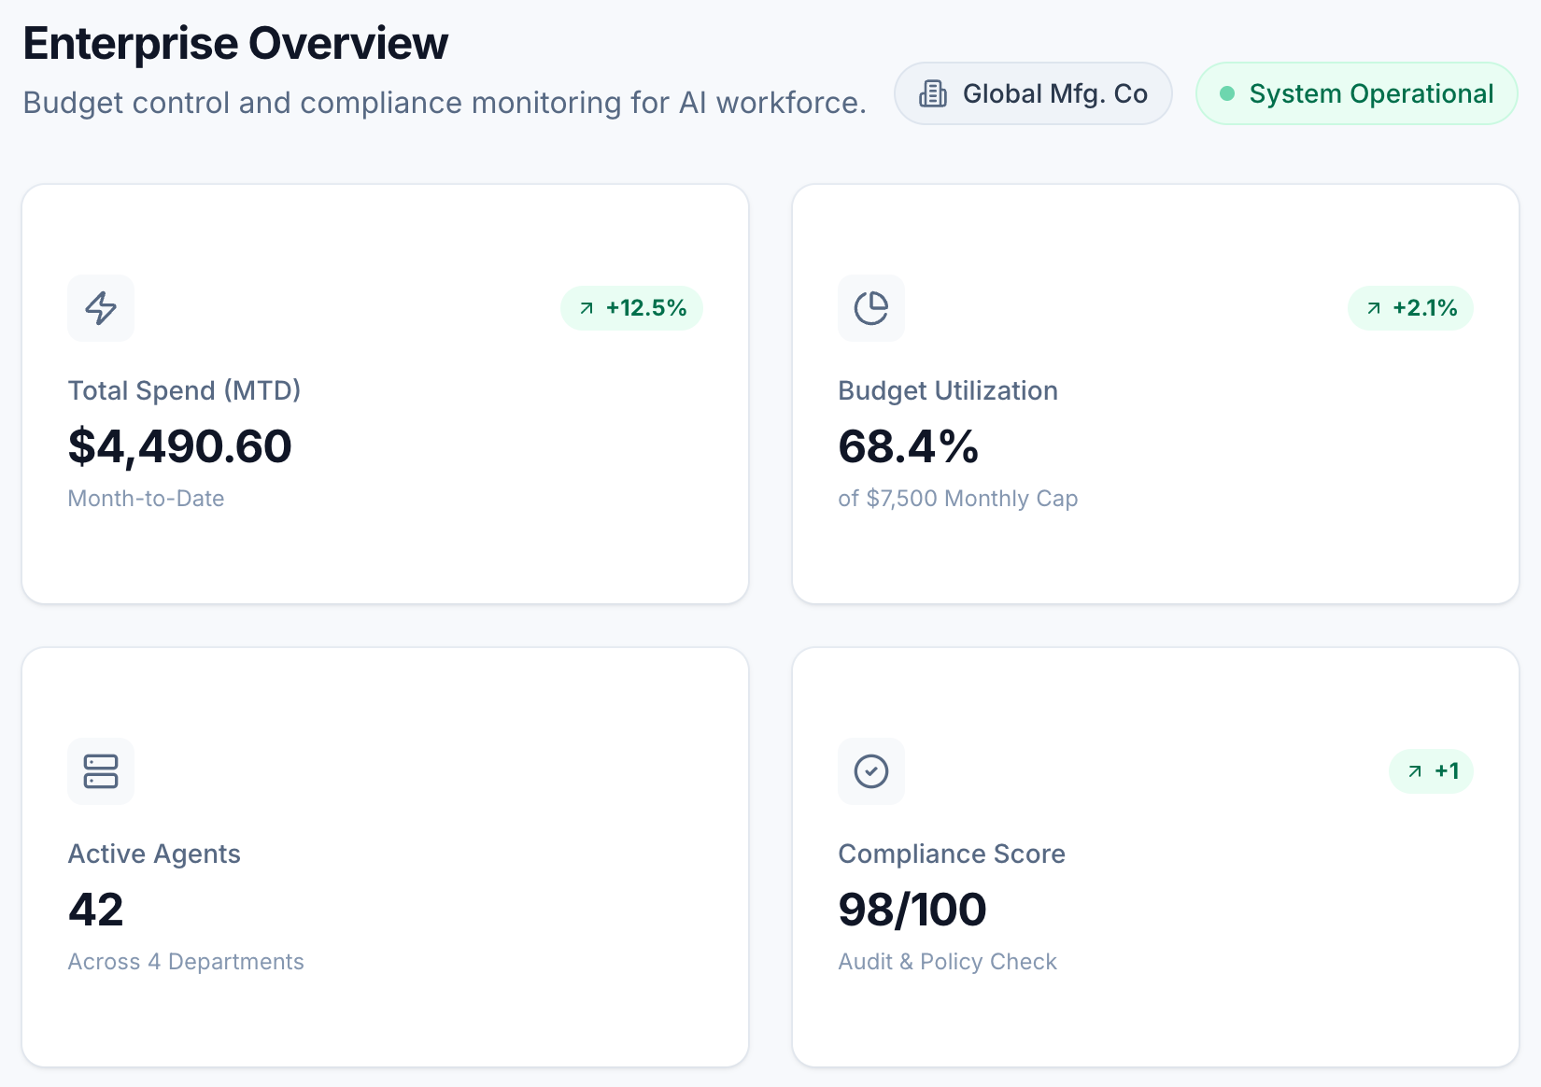
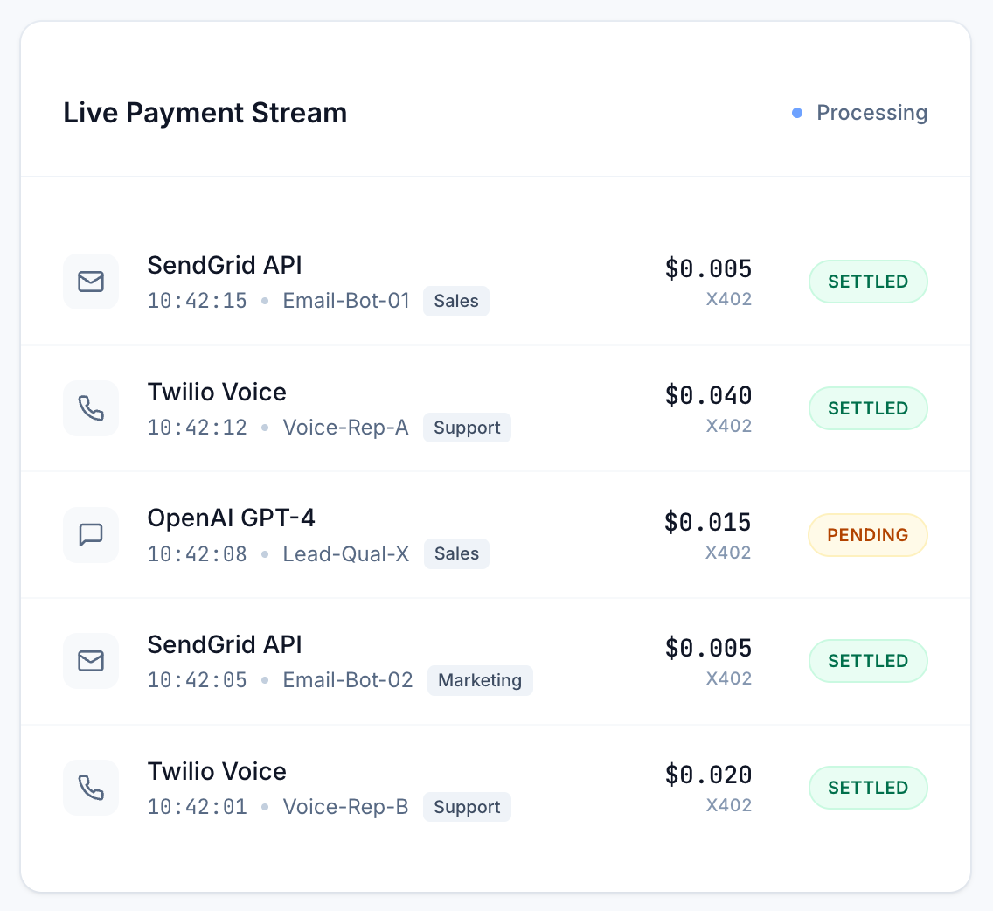

Example: Cost and Revenue Dashboard
Drop-in components
Fast CLI
Custom dashboards
Copy–paste and they work immediately.
Install in under 5 minutes with minimal setup.
UI freely—charts, panels, layouts.

Slide 10
Market Opportunity & Strategy
TAM: $2.0 quadrillion
(Payments Industry)
Building The Engine Of The
New AI Economy
$300B
SOM
(AI AGENT PAY)
Strategic
SAM: $3-5 trillion
(AI Agent Commerce)
Move beyond single tasks to agent‑to‑agent commerce where outcomes are priced, settled, and audited.
Entry Points
Enterprise pilots
Developer growth
Ecosystem
Source：
QuantumBlack AI by McKinsey: The agentic commerce opportunity: How AI agents are ushering in a new era for consumers and merchants, October 17, 2025

Slide 11
Thank you for
watching.

